Slide 1
The Missing Piece to the Coaching Puzzle
Bruce Wahlgren

Slide 2
Game Plan
Emotions and Behavior
Channeling Techniques
How Can I Use This Stuff?

Slide 3
Job Seeker Services 5 Steps to Rapid Employment program 50+ Job Seeker program
Bruce Wahlgren
President and Lead Trainer
Professional Development
Soft Skills Curriculum & Training

Slide 4
Wyatt
Wyatt & Grampa

Slide 5
Emotions Determine Quality of Life
(Not Wyatt)

Slide 6
“We all need a daily checkup from the neck up to avoid Stinkin’ Thinkin’ which ultimately leads to hardening of the attitudes”
Zig Ziglar

Slide 7
Change your thinking, change your emotions

Slide 8
The Two Truths about Emotions
CREATE
CREATE
CREATE
CREATE
CREATE
CREATE
#1

Slide 9
The Two Truths about Emotions
#2
DESTROY
DESTROY
DESTROY
DESTROY
DESTROY
DESTROY

Slide 10
The Two Truths about Emotions
CREATE
CREATE
CREATE
CREATE
CREATE
CREATE
#1

Slide 11
The Two Truths about Emotions
#2
DESTROY
DESTROY
DESTROY
DESTROY
DESTROY
DESTROY

Slide 12
The Two Truths about Emotions
CREATE
CREATE
CREATE
CREATE
CREATE
CREATE
#1

Slide 13
The Two Truths about Emotions
#2
DESTROY
DESTROY
DESTROY
DESTROY
DESTROY
DESTROY

Slide 14
The Two Truths about Emotions
CREATE
CREATE
CREATE
CREATE
CREATE
CREATE
#1

Slide 15
The Two Truths about Emotions
#2
DESTROY
DESTROY
DESTROY
DESTROY
DESTROY
DESTROY

Slide 16
Emotional Channeling Techniques

Slide 18
Your Mind is a Remote Control

Slide 19
Your Turn

Slide 20
We Get What We Focus On

Slide 21
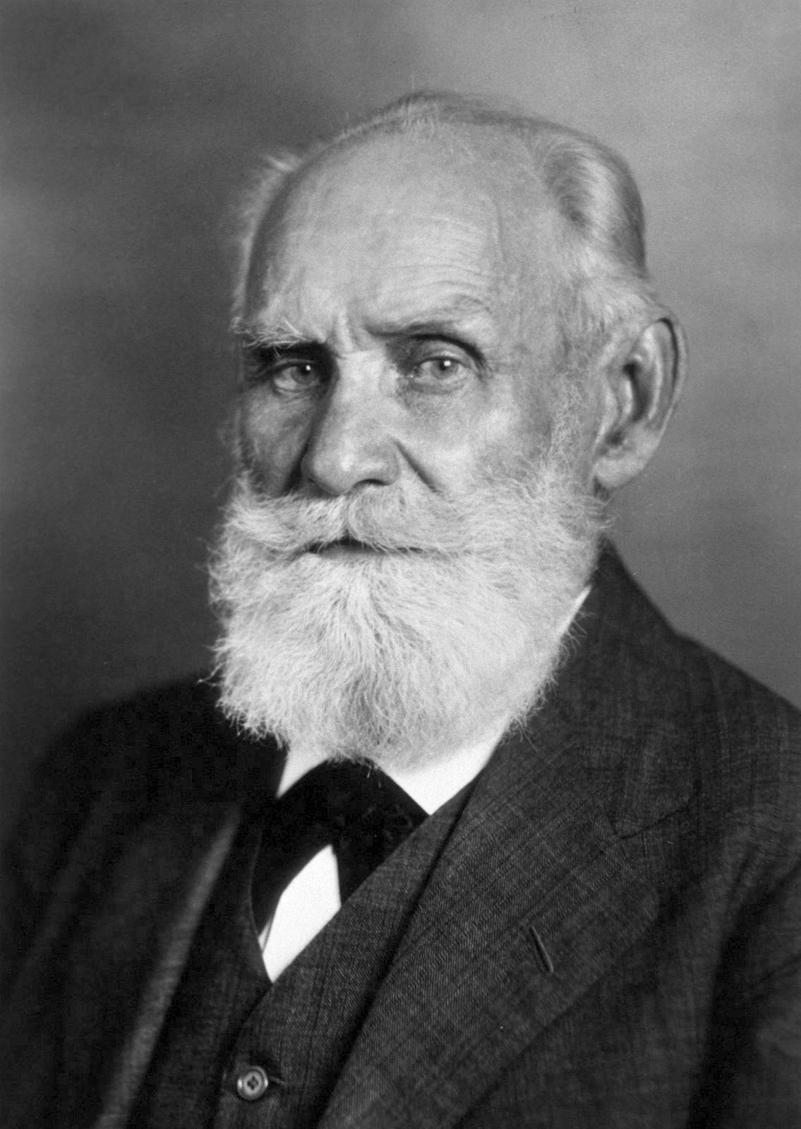
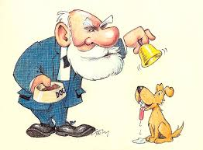
Ivan Pavlov

Slide 22
Watch Your Language
Creates Fear
Creates Hope
Job Search
Networking
Unemployed
Job Campaign
Creating personal sales force
Changing jobs/careers

Slide 23
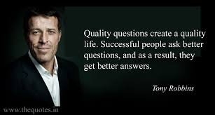
Ask Courageous Questions

Slide 25
My Lessons My Commitments
Application

Slide 26
Thank You!
Bruce Wahlgren

